Slide 1
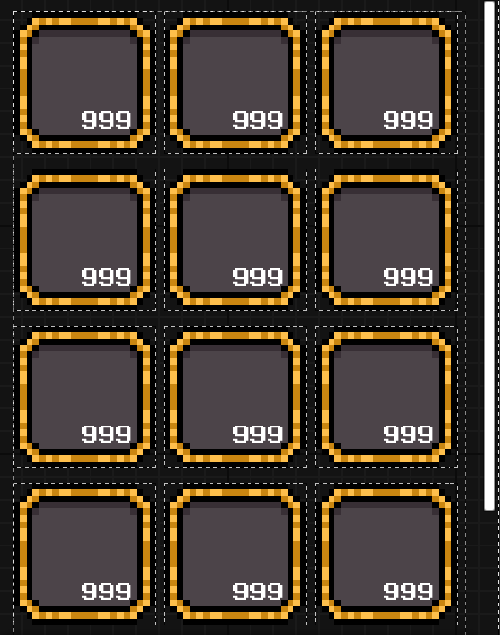
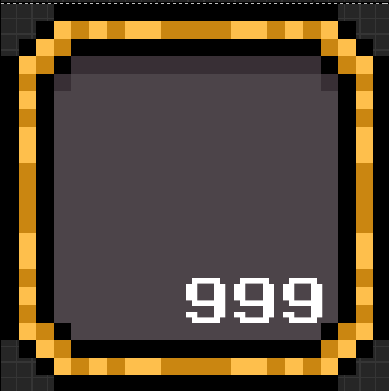
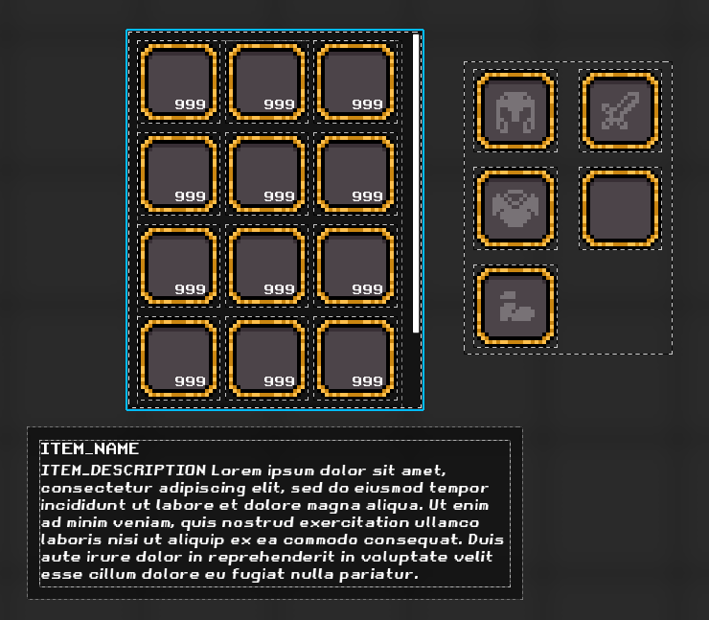
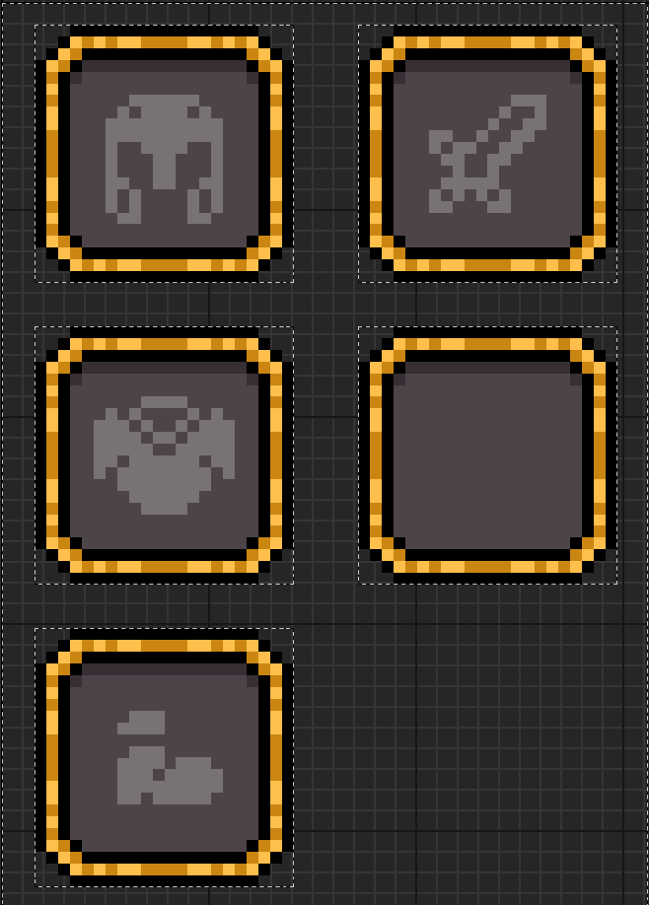

Classes de base
WBP_Slot
Ensemble de
WBP_Slot_Group
Ensemble de
WBP_Inventory
Classes Enfants
WBP_Slot_Item
WBP_Slot_Accepted_Types
…
WBP_SG_Player_Item
WBP_SG_Chest
…
WBP_Inv_Player
WBP_Inv_Chest
…
Exemple
WBP_Inv_Player

